Slide 1
WHAT’S NEW IN THE ENGLISH DEPARTMENT?
Mepham High School PTSA – November 27,2017

Slide 2
HELLO
I AM MARY DONNELLY
District English Chairperson since September 2015
Grand Avenue Middle School
Mepham High School

Slide 3
ADVANCED PLACEMENT OFFERINGS
1
Opportunities for Juniors and Seniors

Slide 4
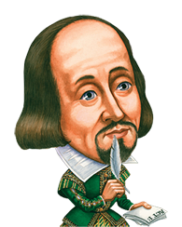
AP English Language & Composition
AP English Literature & Composition
Can be taken as a junior or a senior
Suitable for all students
Students read mostly nonfiction
Offered to seniors
Best suited for strong, motivated readers & writers
Focus on reading, analyzing & writing about imaginative literature from various periods.
Develops “critical literacy”
Facilitates “informed citizenship”

Slide 5
Students who challenge themselves with RIGOR – AP or credit-bearing courses – stand out in the college admissions process.
Students build college skills in the safety of a high school classroom with the guidance of a supportive teacher.
EARN COLLEGE CREDIT & SKIP INTRODUCTORY COURSES

Slide 6
NOTHING TO FEAR: Many colleges grant credit- and placement as well- based on a 3 or better on an AP Exam. The cost of the exam is minimal compared to the cost of 3 college credits.

Slide 7
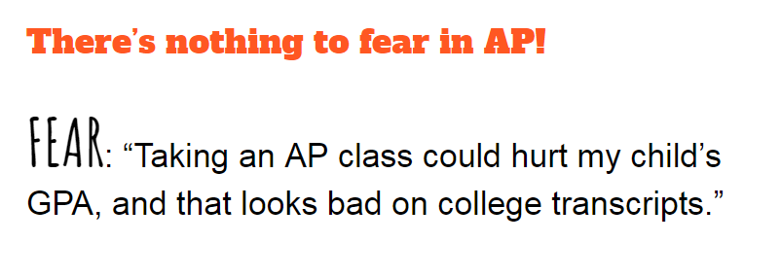
NOTHING TO FEAR: The decision to take an AP course shows admissions officers that your child is willing to take on the academic challenge of college-level coursework and expectations.

Slide 8
NOTHING TO FEAR: Children do not have to be traditional “honors track” kids to benefit from a college-level course. Seniors taking E4 AP Language have the additional benefit of preparedness from the Common Core English Regents exam.

Slide 9
ELECTIVE OFFERINGS
2
Awesome learning experiences built for college & beyond

Slide 10
ALL ENGLISH ELECTIVE OPTIONS FOR 2018-2019
COLLEGE MEDIA
COLLEGE PUBLIC SPEAKING
CREATIVE WRITING I: FICTION
CREATIVE WRITING II: NONFICTION
JOURNALISM
PATHWAYS
SAT/ACT STRATEGIES
SOCIAL MEDIA & BLOGGING
STRANGER FICTION
VOICES OF THE PAST

Slide 11
NEW ELECTIVES

Slide 12
HEROES AND MONSTERS OF THE PAST, PRESENT AND FUTURE
WELCOME TO BELLMORE

Slide 13
SOCIAL MEDIA
& BLOGGING
Safe and supportive exploration of how students can leverage social media for future success

Slide 14
PATHWAYS:
Finding and Filling Your Life with Your Passion

Slide 15
For More Information:
Visit the Mepham HS English Department website for more information about all of the English elective offerings:
mephamenglish.weebly.com

Slide 16
THANKS
ANY QUESTIONS?
516-992-1553
mdonnelly@bmchsd.org

